Slide 1
Salary Data Analysis
And the wage gap.

Slide 2
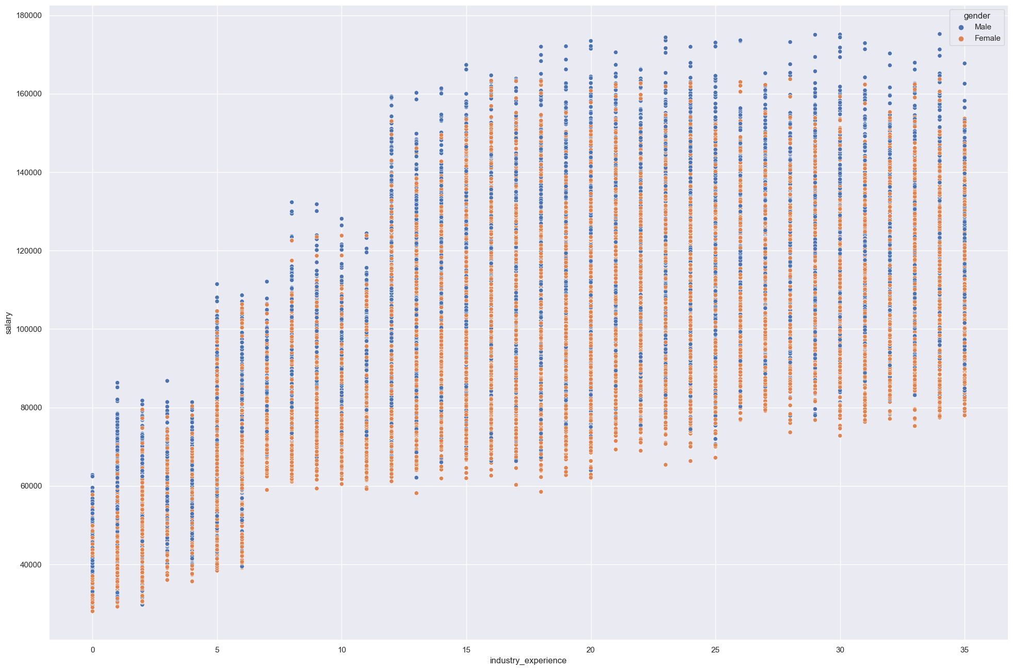

Slide 3
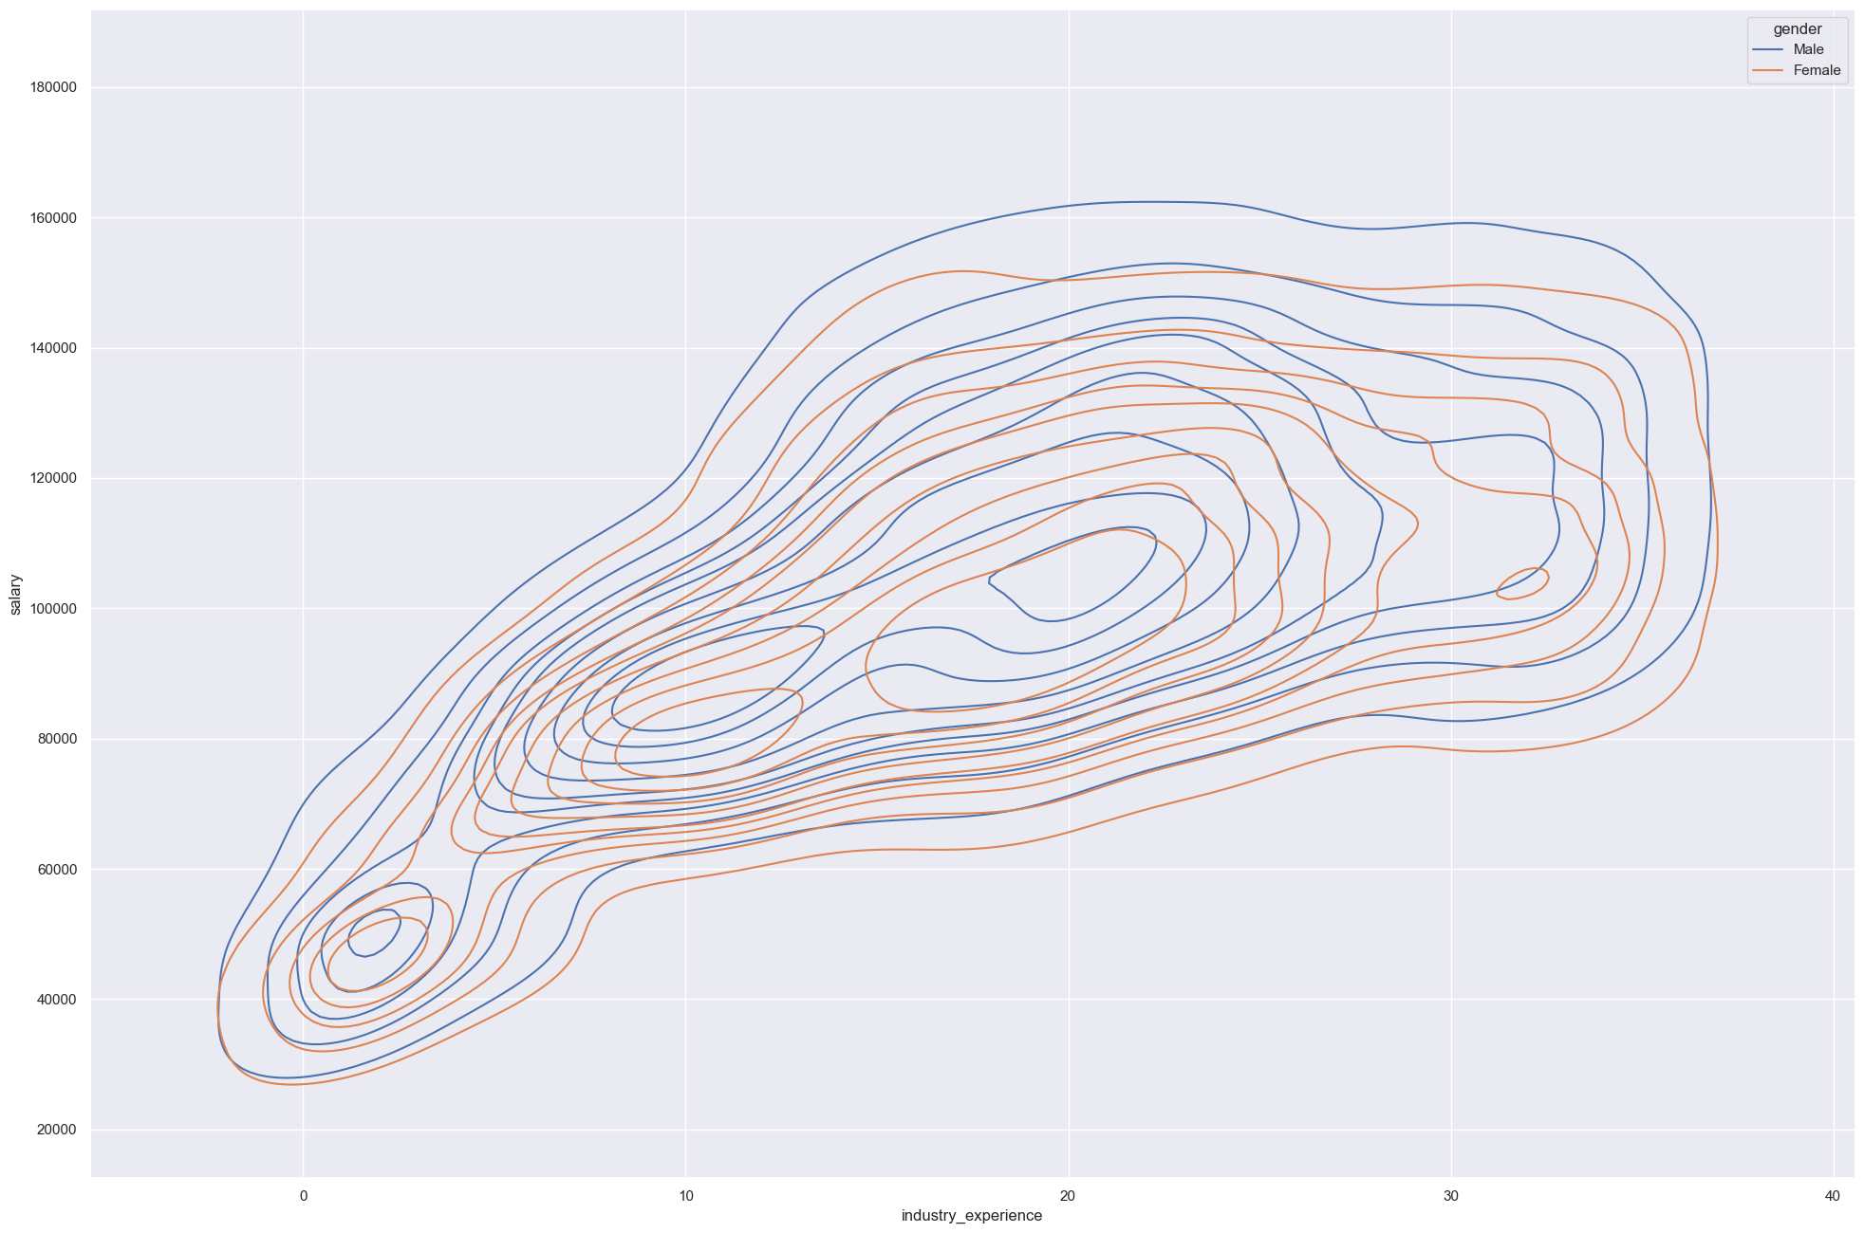

Slide 4
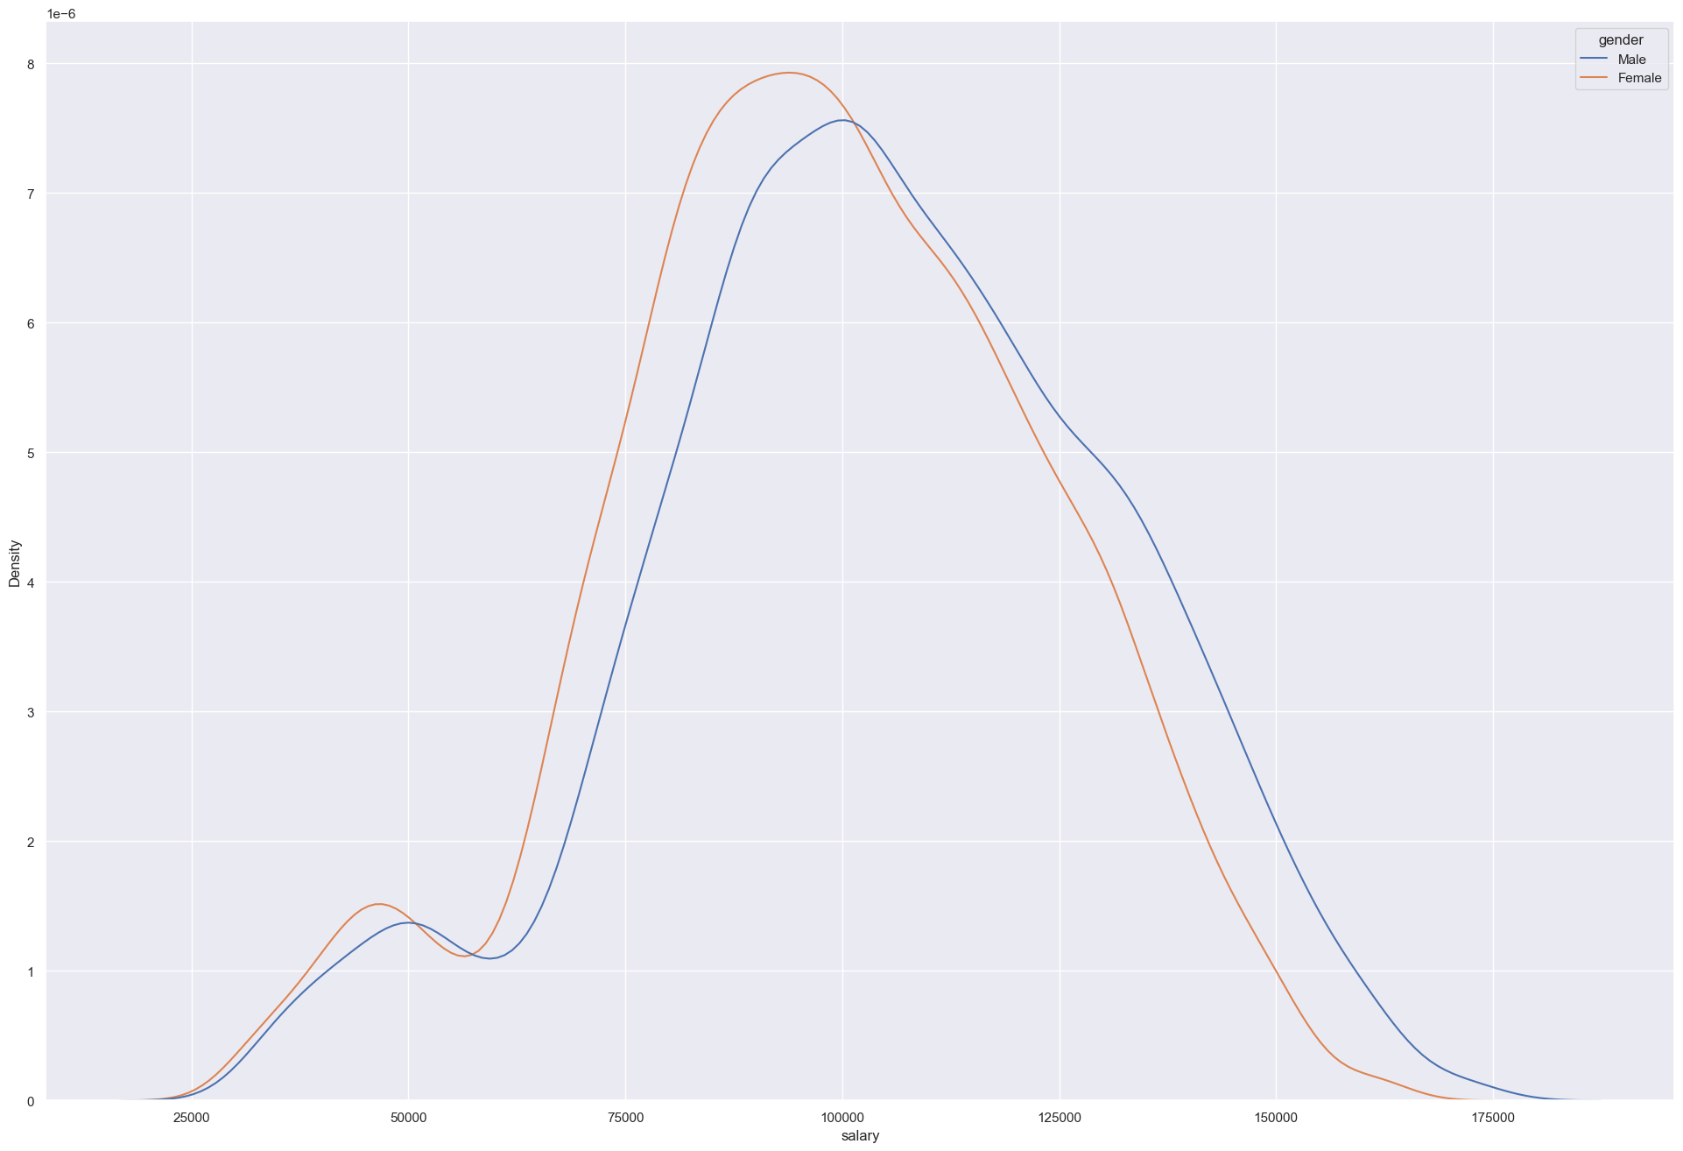

Slide 5
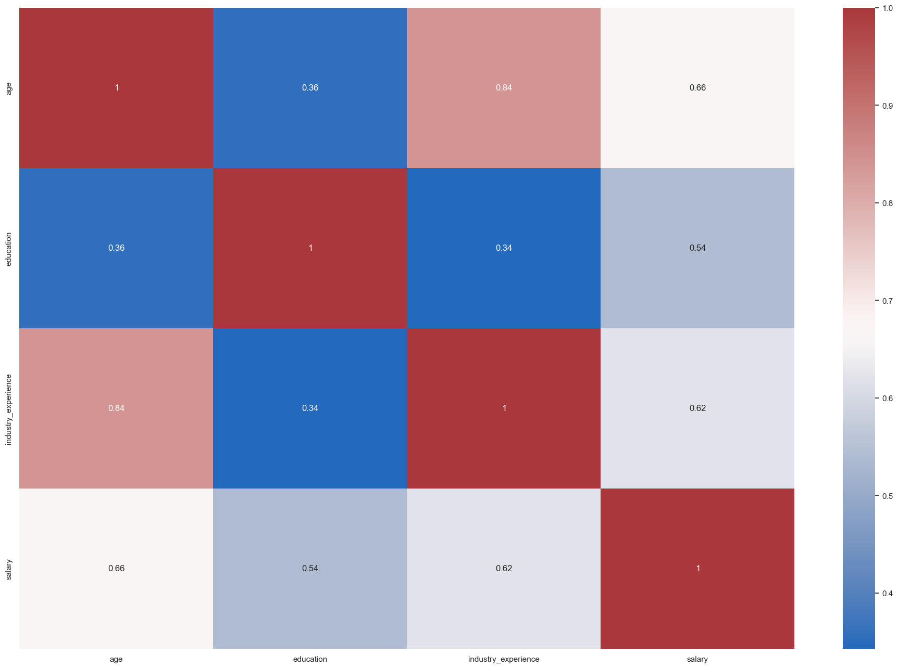

Slide 6


Slide 7
